Slide 1
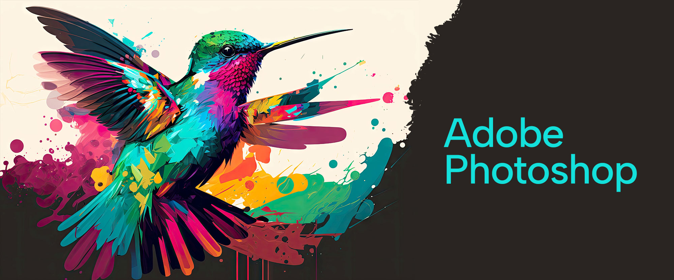

Slide 2
About today…
Color Correction
Adjustment Layer
Types of Adjustment Layer

Slide 3
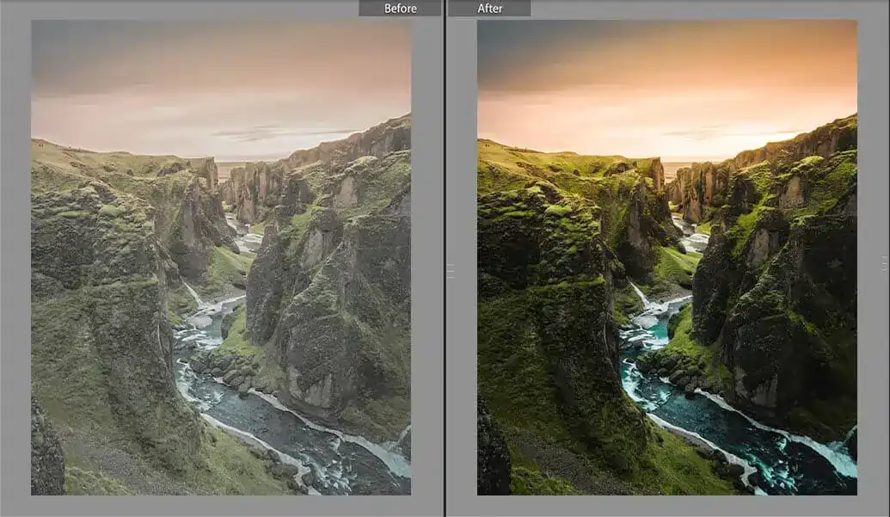
What is Color Correction?
Definition
The process of adjusting the colors of an
image to make them appear more natural
or to achieve a desired effect
Importance
The process of adjusting the colors of an image to make them appear more natural or to achieve a desired effect
Corrects color imbalances
Enhances image quality
Creates a specific mood or artistic effect

Slide 4
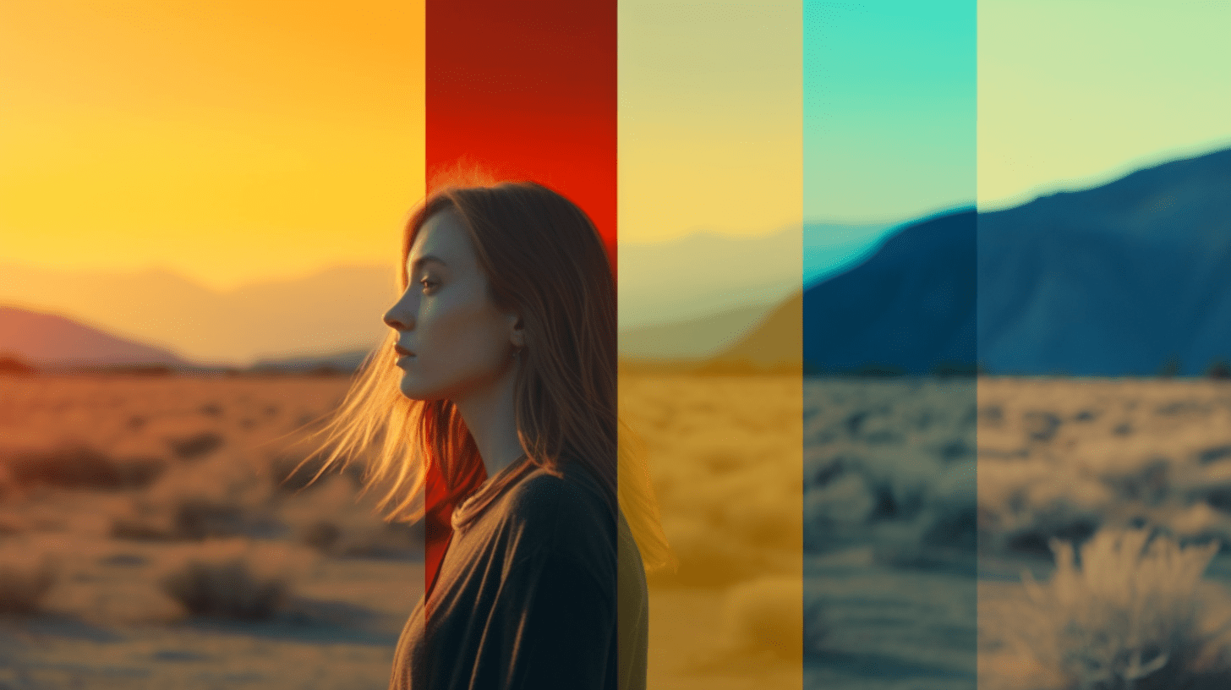
Introduction to Adjustment Layers
Definition
Non-destructive layers that allow you
to make changes to an image without
permanently altering the original
Benefits
Flexibility to edit adjustments at any time
Ability to use masks for targeted corrections
Preserve original image quality

Slide 5
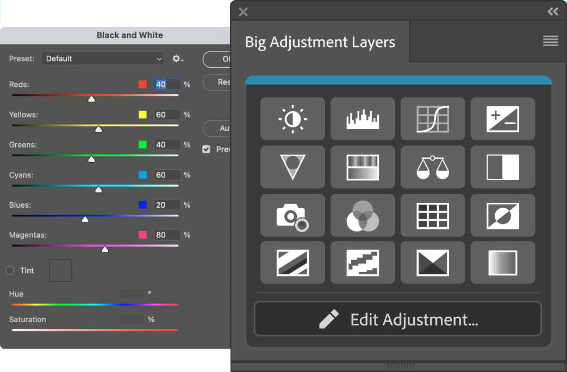
Types of Adjustment Layers
Brightness/Contrast
Adjusts light and dark values
Levels
Controls tonal range and color balance
Curves
Fine-tunes brightness and contrast
Exposure
Adjusts exposure levels
Hue/Saturation:
Modifies color intensity and hues
Color Balance
Adjusts the balance of colors
Black & White
Converts an image to grayscale

Slide 6

How to Apply Adjustment Layers
Steps
Open your image in Photoshop.
Select the Adjustment Layer icon at the bottom of the Layers panel
Choose the type of adjustment layer you want to apply
Use the properties panel to make adjustments
Tip
Use the layer mask to apply adjustments to specific areas

Slide 7
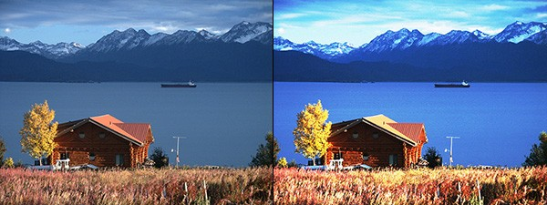
Practical Example - Brightness/Contrast
Steps
Open your image in Photoshop.
Apply a Brightness/Contrast adjustment layer
Adjust the sliders to improve image quality
Use the layer mask to fine-tune specific areas

Slide 8
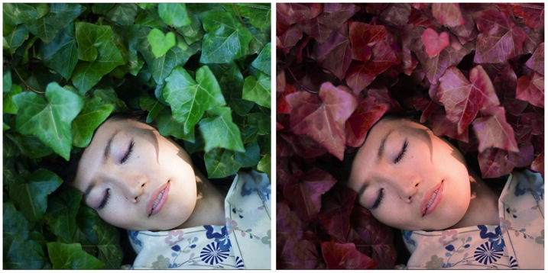
Practical Example - Hue/Saturation
Steps
Open your image in Photoshop.
Apply a Hue/Saturation adjustment layer
Apply a Hue/Saturation adjustment layer
Target specific colors for selective adjustments

Slide 9
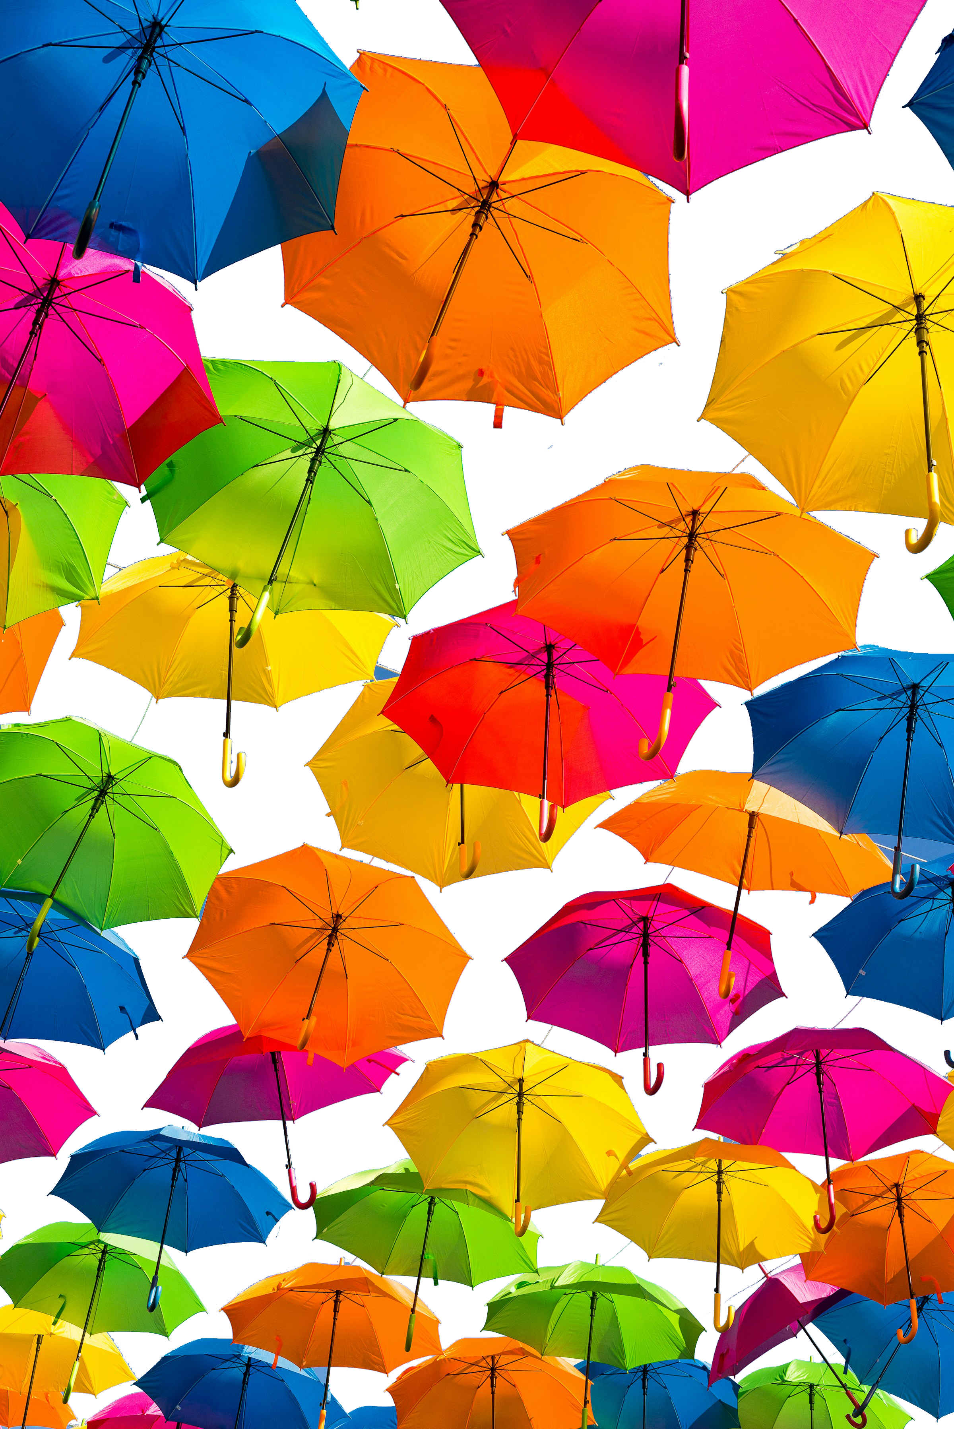
Using Multiple Adjustment Layers
Combining multiple adjustment layers for more complex corrections
Start with a Levels adjustment layer
Add a Color Balance layer
Finish with a Curves layer for final tweaks

Slide 10

Effective Color Correction
Work non-destructively using adjustment layers
Use layer masks to target adjustments
Adjust individual color channels for precise control
Regularly compare with the original image to avoid over-correction

